Slide 1
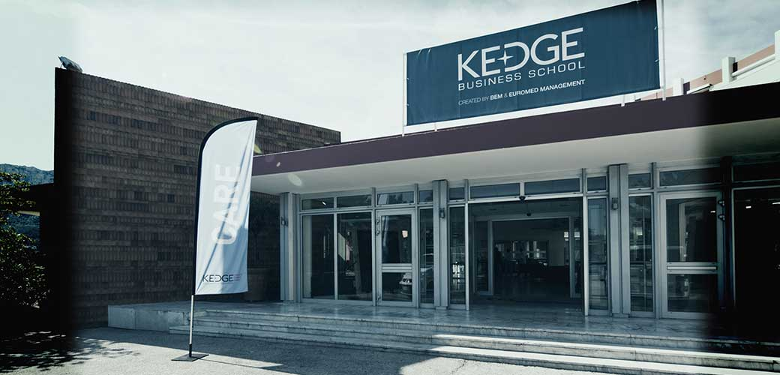
KEDGE Double Degree Program

Slide 2
Program Structure
First Year at NSYSU You’re advised to
complete your core/mandatory courses of your Master’s degree in NSYSU in Year 1
Second Year at KBS
Required courses

Slide 3
Admission Requirement
Requirement: Must be IBMBA students;
Quota: 5/ per year
Language Requirement: TOEFL iBT 79/ IELTS 6
Application Period: November 1st, 2017-December 1st, 2017
You can also refer to the handbook to know more about the course selection.

Slide 4
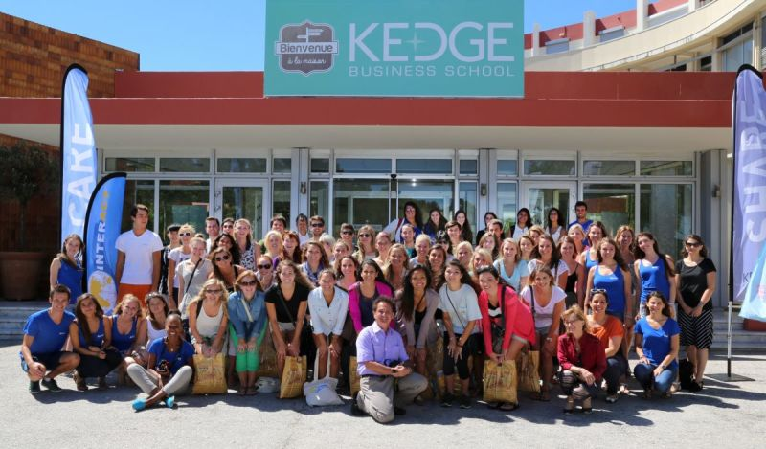
Graduation Requirement
Complete two semesters in France; 3 Fundamental Courses to be taken (15ECTS) and 6 in-class elective management (30 ECTS) classes at KEDGE BS to be chosen by the students
Master’s thesis in English
Complete 6 months Internship/ work experience to meet the graduation Requirement

Slide 5
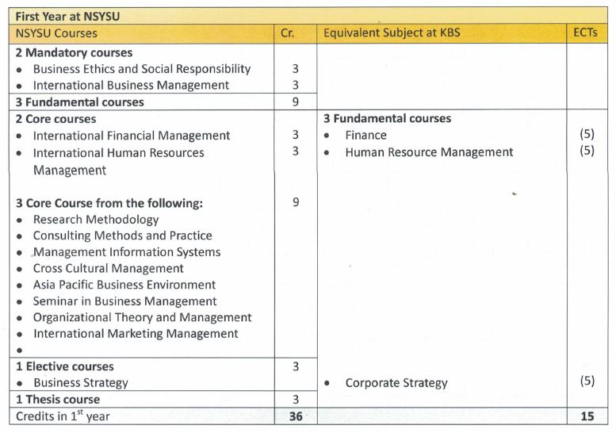
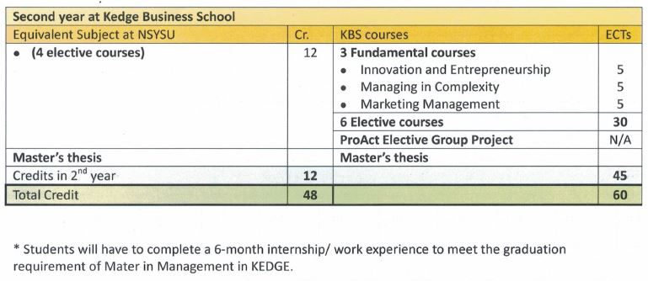
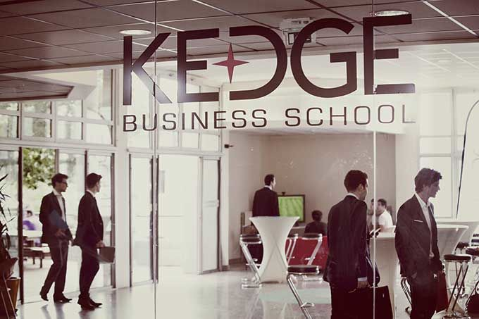
Suggestions for Course Selection

Slide 6
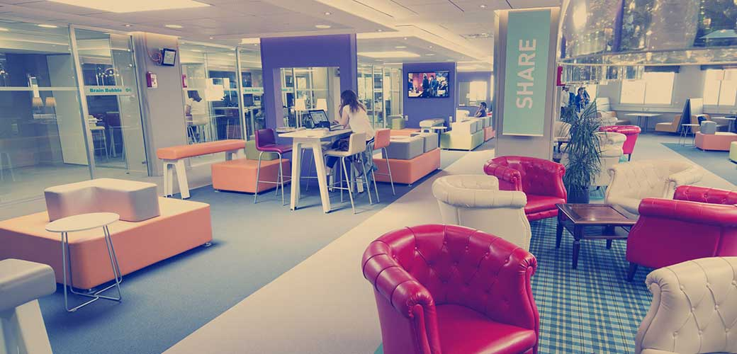
Fee Schedule
Tuition: Registration fee to NSYSU for 2 semesters;
No tuition fees for KEDGE Business School
Credit Fee: 22.5 Credits X Credit Fee of IBMBA (NTD 3,000/ per credit)
Students should take care of their own travel and living expenses.

